Slide 1
Magic numbers
File signatures
-Deepak Keshav

Slide 2
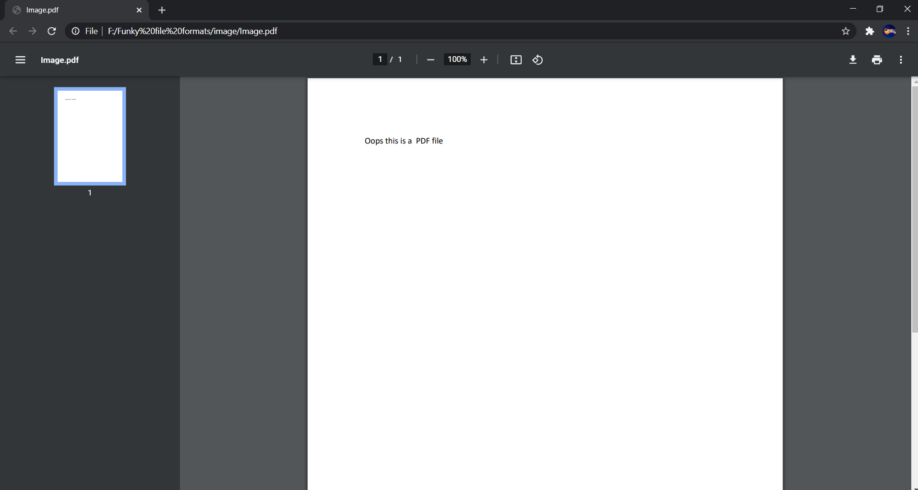
Let us consider his file image.pdf

Slide 3
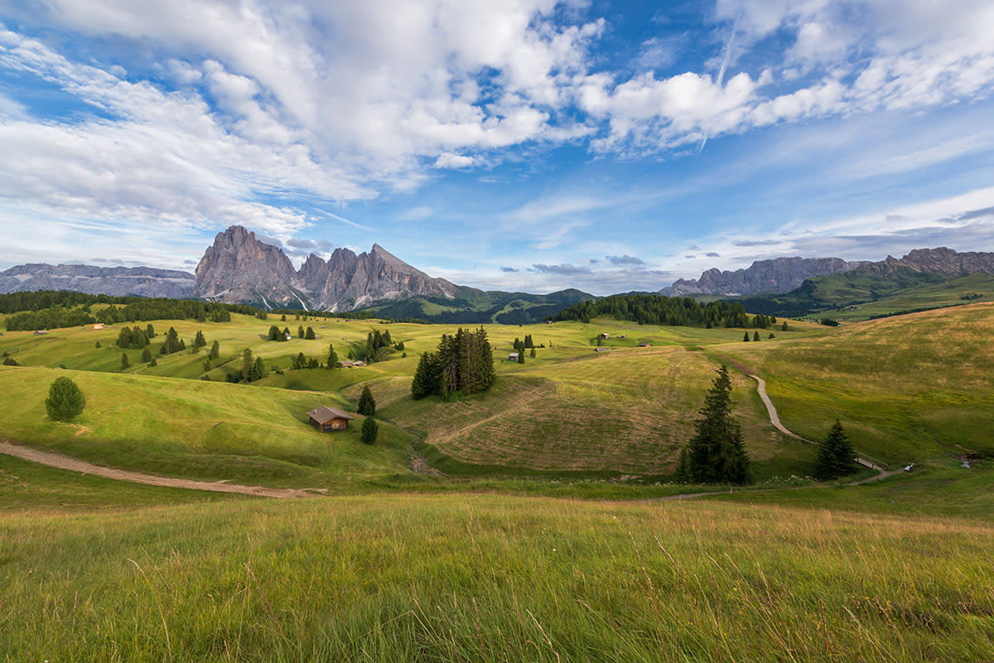
Opening it with paint gives me this image

Slide 4
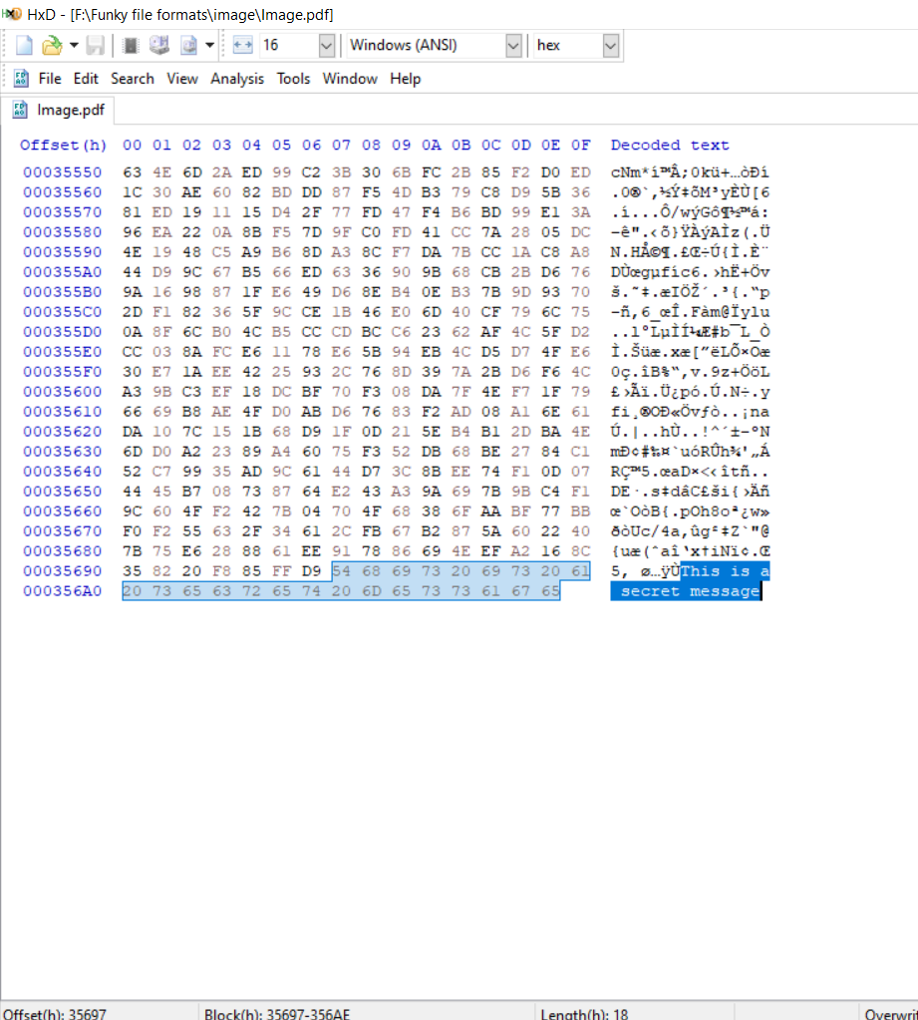
And a hidden message

Slide 5
Ok, How do we identify things?
Confused?
Is it by its appearance?
Is it by its sound?

Slide 6
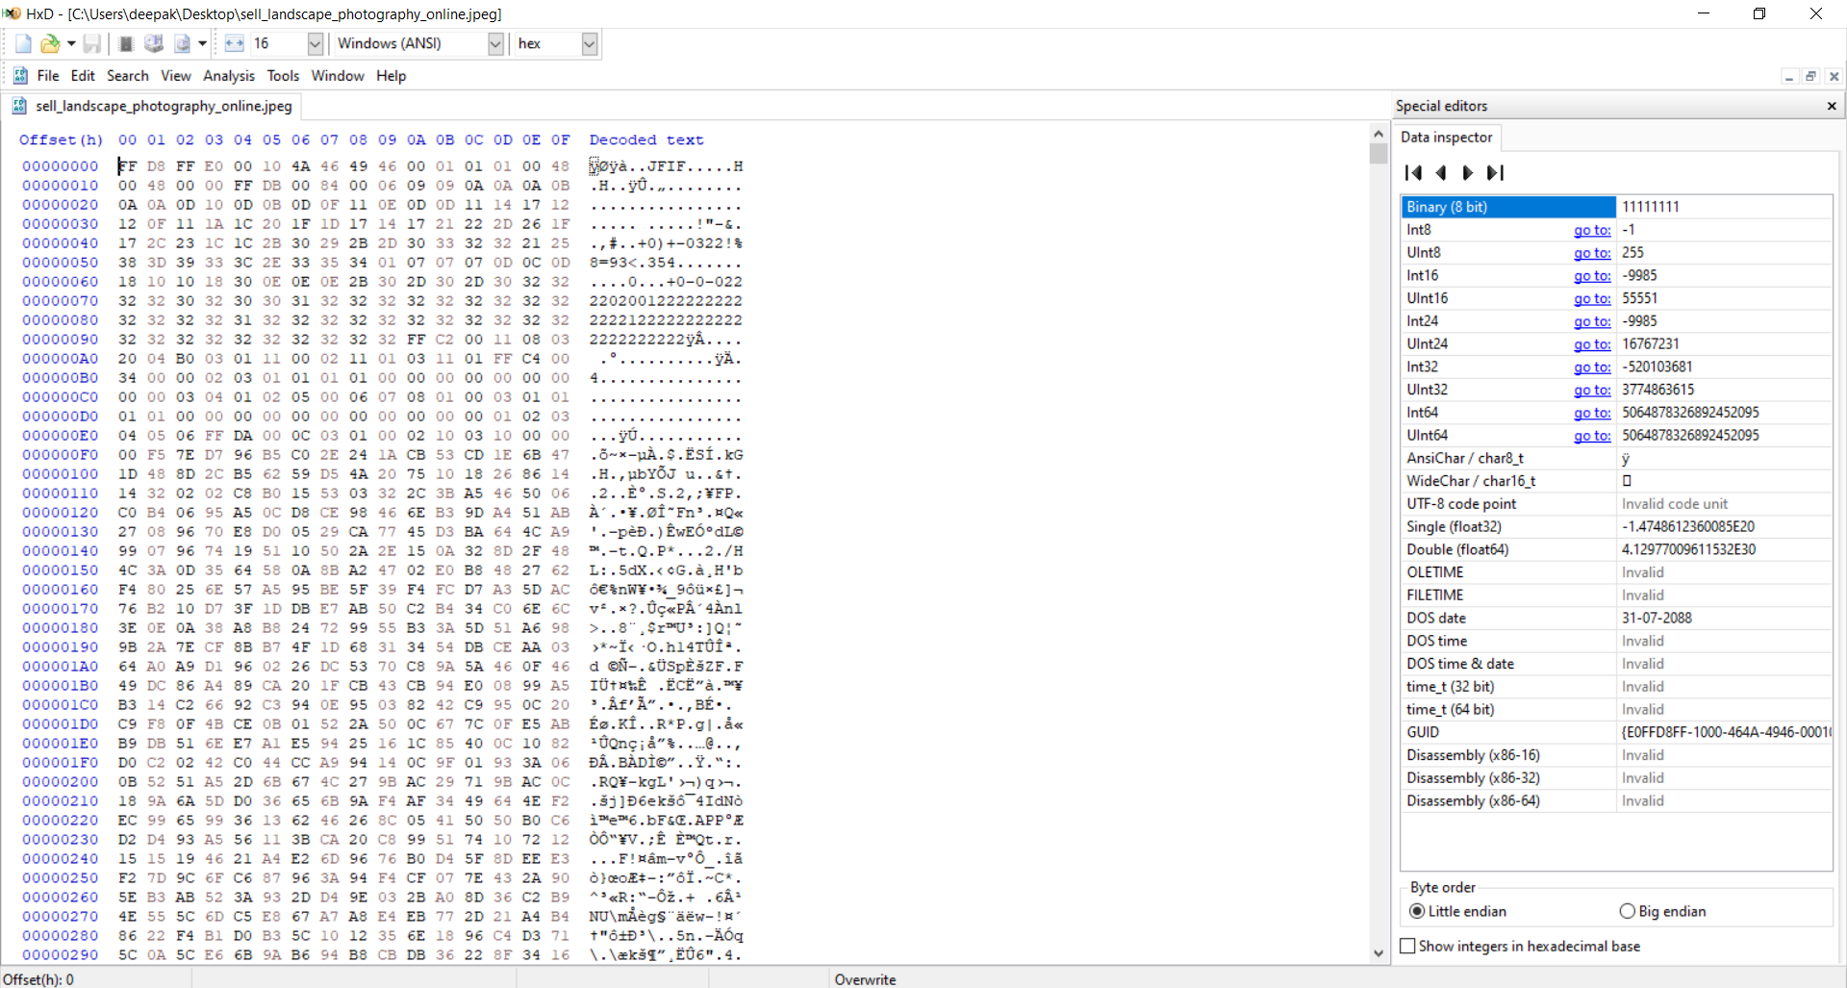
Similarly all files have something called signatures or magic

Slide 7
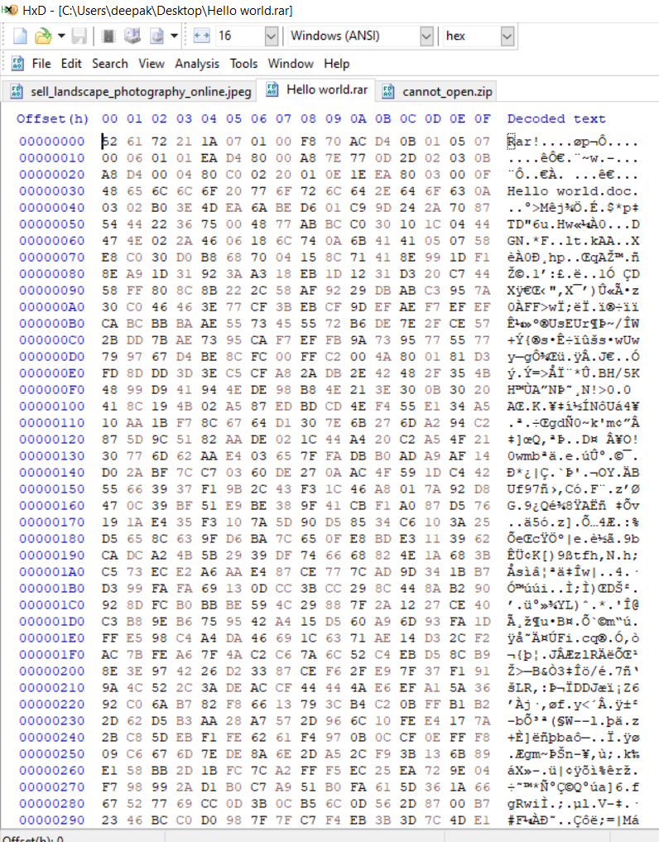
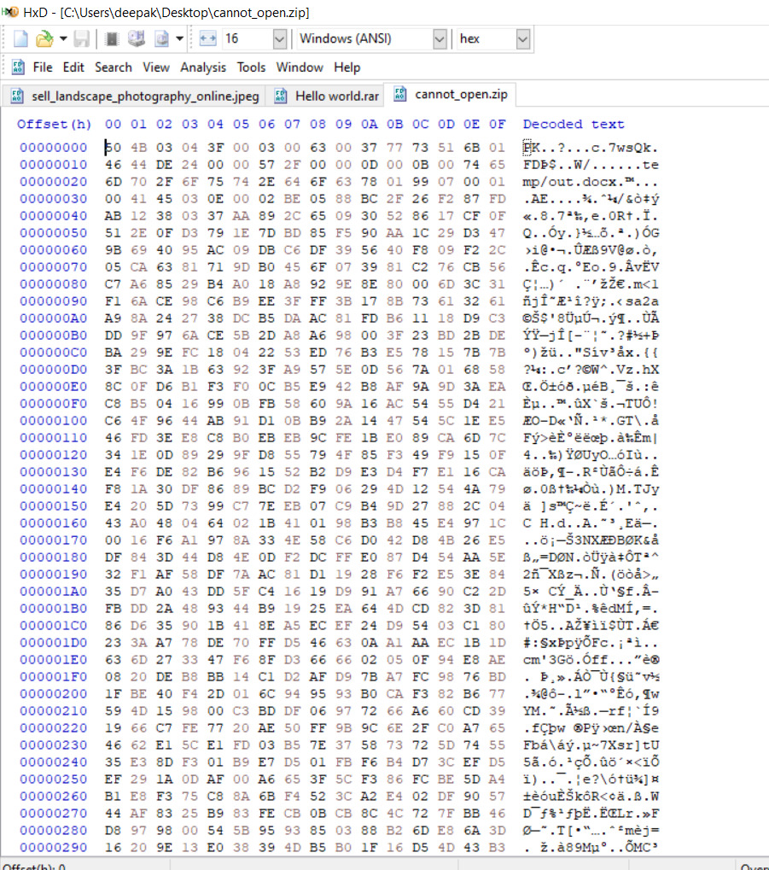
Some more examples
Rar file
Zip file..Fun fact PK is the co-founder of zip

Slide 8
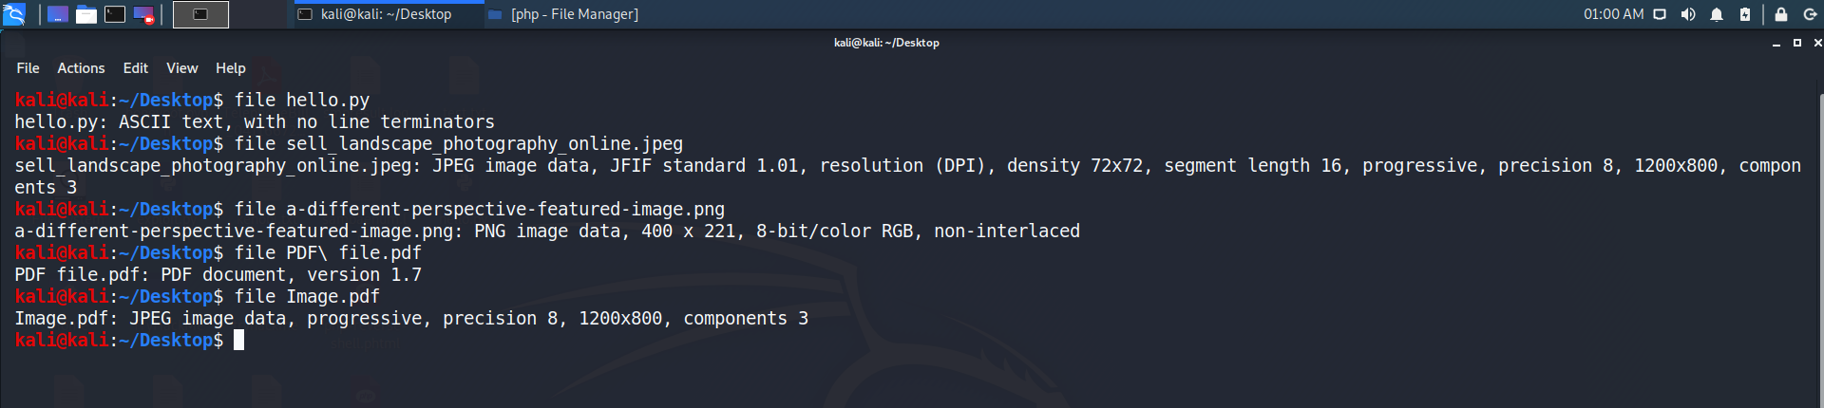
It is a utility used in Unix/linux machines to find the file type based on their signatures
File command

Slide 9
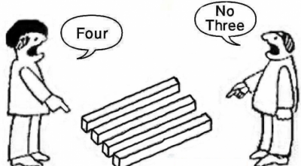
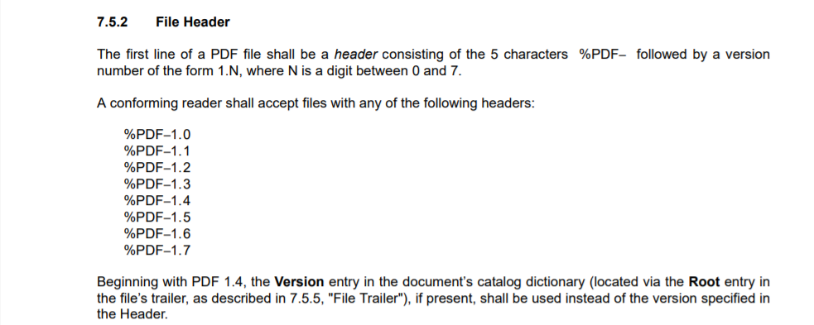
How does the software see?
Each developer has different perspective and different algorithms as per his/her knowledge
Consider an example of PDF
But there are situations where there are NULL binaries or noises
In font of the signatures like this but the PDF still works
So each software parses files in a different way
Some software searched the head signature in the first 1024 bytes and stop parsing as soon as end reaches

Slide 10
How did we open jpeg and pdf in the same file?
Going back to the initial slides
Simple
PDF reader searched for valid head signature and EOF
Whereas Paint, image viewers searched for the image signature
Example:
In the first 1024 bytes if there is a image file contents or any other file contents, the pdf reader either ignores It or mark the file as corrupted.

Slide 11
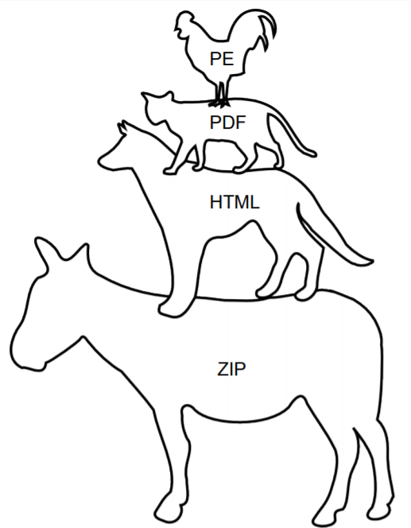
Consider a situation
Here comes the best part known as Polyglot
I am having a file image.jpg
I am adding a zip file after the EOF of the image signature
I am sending it to the victim
By default , the computer is taught to open image_viewer.exe when it sees .jpg file
The viewer displays it as valid image
But when the attacker has access to the machine , he then unzips the file inside the image file
In this case we can use Binwalk tool to find if there are any embedded files inside a file

Slide 12
Why Mime type and multi extension file upload must be restricted in a web app!
It all makes sense now
Mime types mostly use signatures to verify the file types
These techniques can easily bypass the firewall protection

Slide 13
Ange’s recipes
Never forget to:
● open your PDFs in a hex editor
● open your pictures in a sound player
● run your documents in a console emulator
● encrypt/decrypt with any cipher
● double-check what you printed

Slide 14
Ange Albertini’s slide and research
Youtube - https://www.youtube.com/watch?v=hdCs6bPM4is
More references-
https://www.youtube.com/watch?v=VVdmmN0su6E
This is a research where there are many Algorithms and techniques.
The best way to start is by googling

